Slide 1
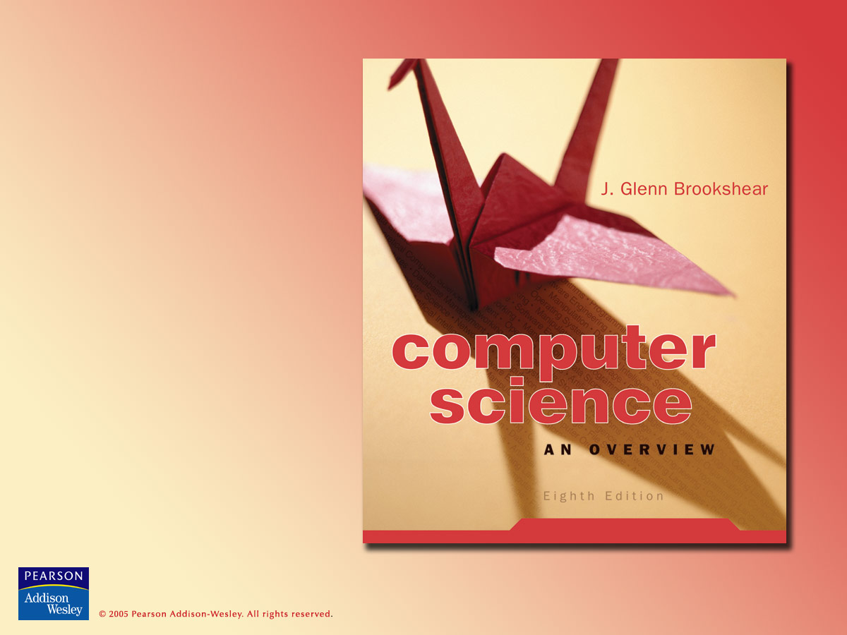
Chapter 3
Operating Systems

Slide 2

Chapter 3 Operating Systems
3.1 The Evolution of Operating Systems
3.2 Operating System Architecture
3.3 Coordinating the Machine’s Activities
3.4 Handling Competition Among Processes
3.5 Security

Slide 3
Some functions of an operating system
Oversee operation of computer
Store and retrieve files
Schedule programs for execution
Execute programs

Slide 4
Evolution of shared computing
Batch processing
Job queue
Time-sharing
  Multi-tasking: multiple tasks for a single user
  Interactive processing
  Real-time processing
Scheduling multiprocessor machines

Slide 5
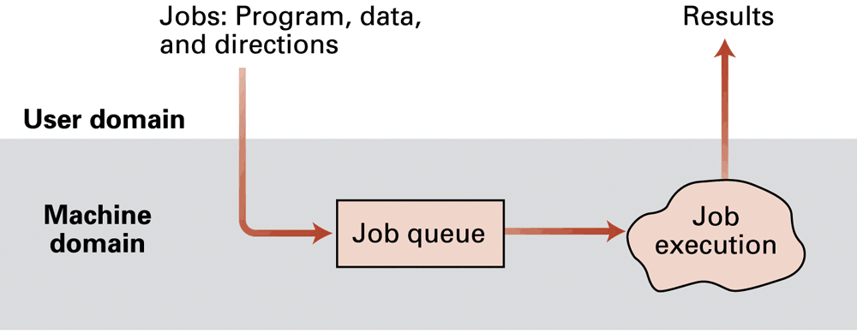
Figure 3.1 Batch processing

Slide 6
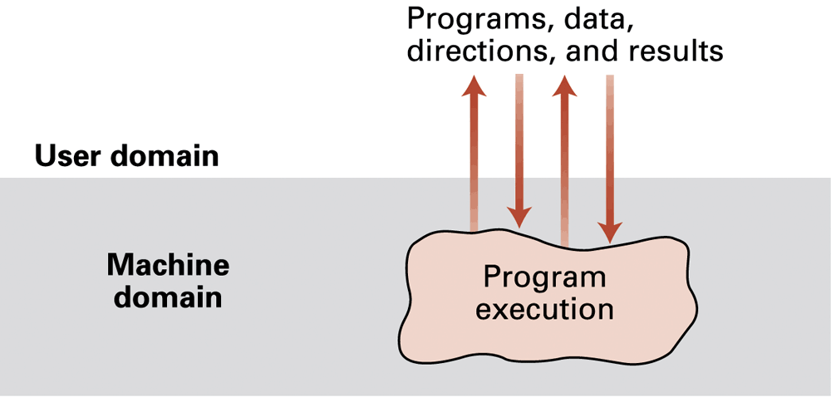
Figure 3.2 Interactive processing

Slide 7
Types of software
Application software
  perform specific tasks for users
System software
  perform tasks needed by all computer systems
  Operating system
  Utility software

Slide 8
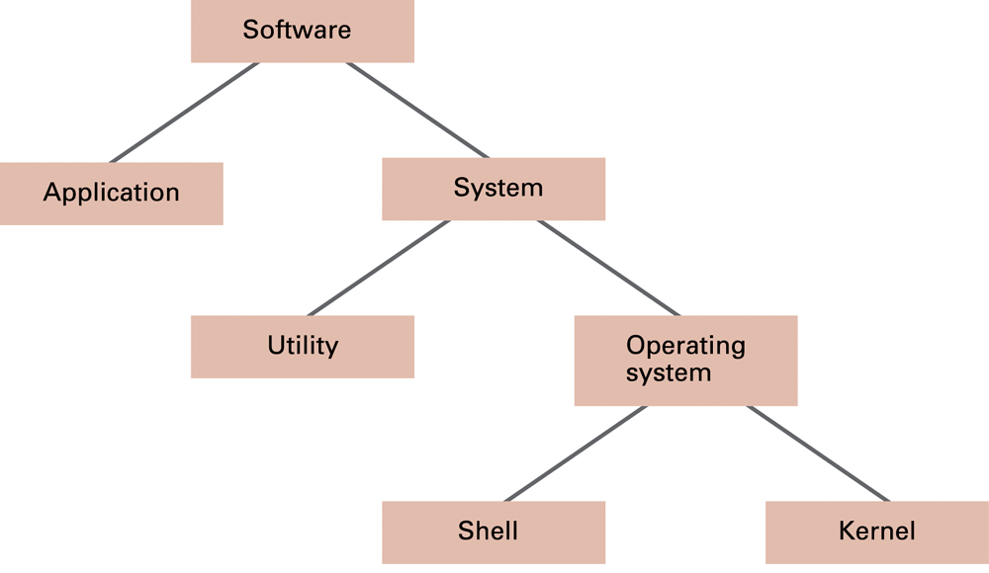
Figure 3.3 Software classification

Slide 9
Components of an operating system
Shell: portion that communicates with users
  Graphical user interface (GUI)
    Window manager
Kernel: contains components performing basic required functions
  File manager
  Device drivers
  Memory manager
  Scheduler and dispatcher

Slide 10
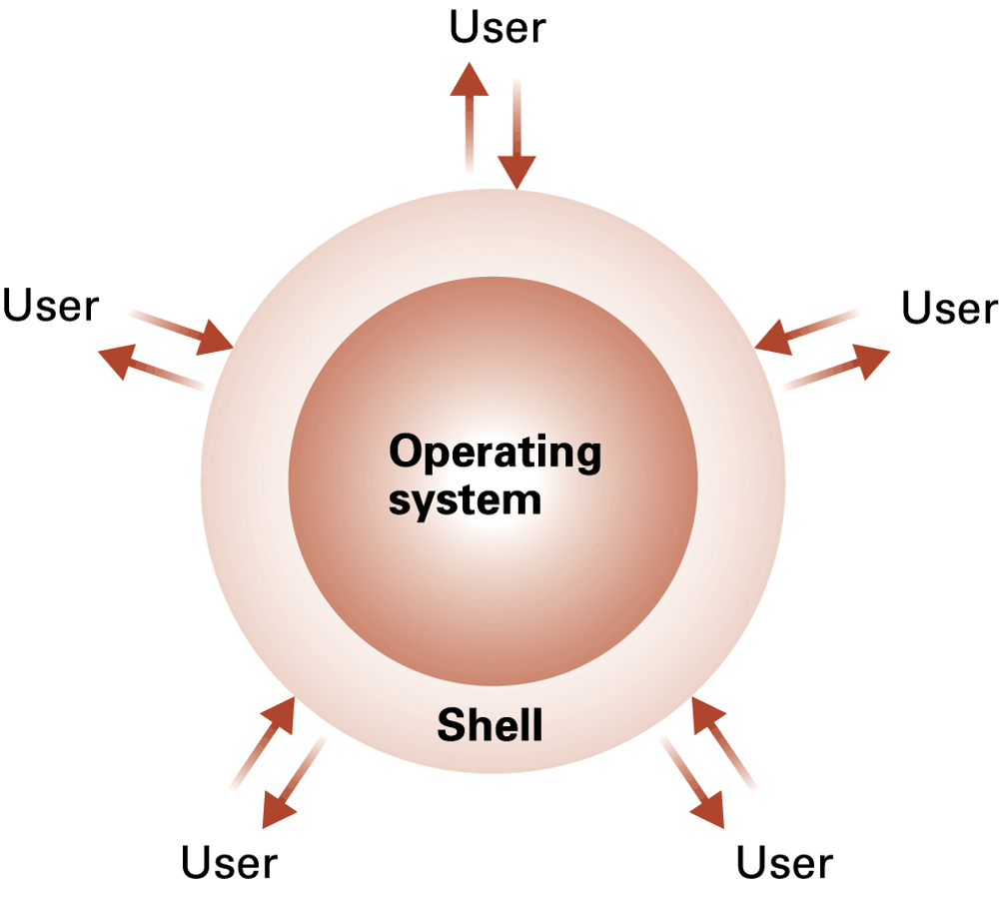
Figure 3.4 The shell as an interface between users and the operating system

Slide 11
File Manager
Directory or folder: user-created group or bundle of files
Path: position of a file in directory hierarchy
File descriptor: information needed to access an open file

Slide 12
Memory manager
Page: unit of memory managed (a few kilobytes)
Virtual memory: illusionary memory space
  Created by shuffling units of data, called pages, between actual main memory space and mass storage

Slide 13
Getting it started (bootstrapping)
Bootstrap: program in read only memory (ROM)
  Run by the CPU when power is turned on
  Transfers operating system from mass storage to main memory
  Executes jump to operating system

Slide 14
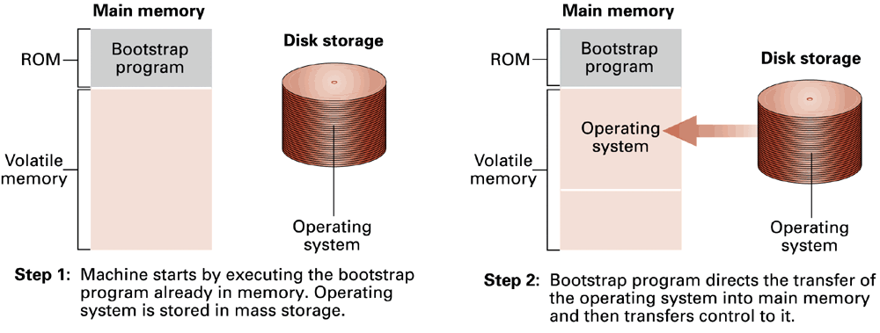
Figure 3.5 The booting process

Slide 15
Processes
Program = a static set of directions
Process = the activity of executing a program
Process state = current status of the activity
  Snapshot of relevant parts of the machine state
  Program counter, other registers, associated main memory

Slide 16
Process administration
Scheduler
  Keeps state of all processes in an process table
    Ready or waiting
    Priority
    Non-scheduling information: memory pages, etc.

Slide 17
Process administration (continued)
Dispatcher
  Gives one time slice or quantum to a process that is ready
  Executes a process switch (or context switch) when the running process’s time slice is over
    Interrupt indicates that time slice is over
    Interrupt handler: part of dispatcher

Slide 18
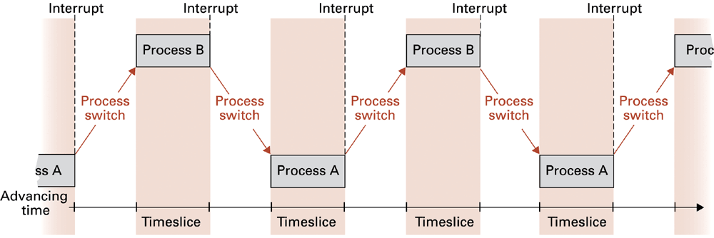
Figure 3.6 Time-sharing between process A and process B

Slide 19
Handling competition for a resource
Semaphore = a control flag telling if resource is in use
  Test and set must be done together for proper function
Critical region = sequence of instructions that should be executed by only one process at a time
  Usually protected by a semaphore
Mutual exclusion = requirement for proper implementation of a critical region

Slide 20
Deadlock
Two processes block each other from continuing
Conditions that lead to deadlock
  1. Competition for non-sharable resources
  2. At least two resources are needed by both processes
  3. An allocated resource can not be forcibly retrieved

Slide 21
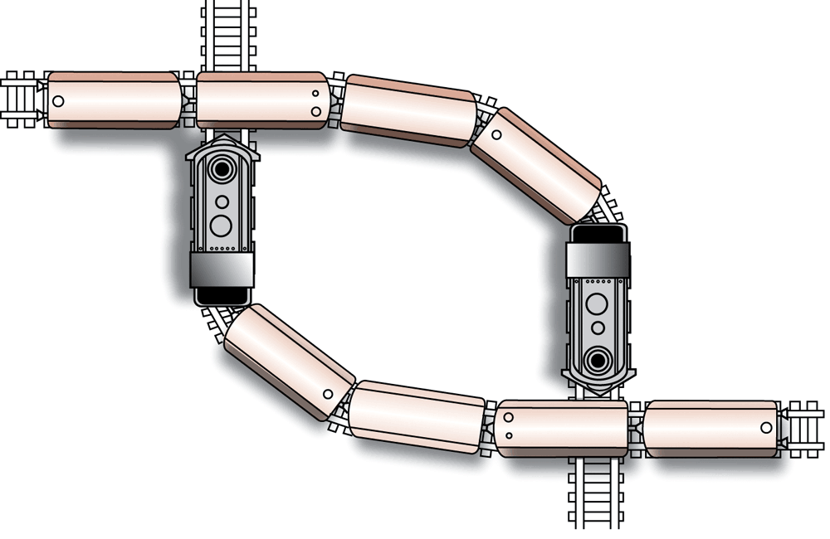
Figure 3.7 A deadlock resulting from competition for nonshareable railroad intersections

Slide 22
Spooling
Postpone requested operation until a later time
  Makes a non-shareable resource appear shareable
    Technique of deadlock avoidance

Slide 23
Security from outside attacks
Most common protection: require user name and password
  Problem: password stealing
  Problem: automated password guessers
  Countermeasures:
    Always tell user when he/she last logged in
    Report repeated bad guesses
    Log the guesser into a captive account to spy on the guesser

Slide 24
Security from attacks from within
Operating system prevents illegal access to resources
  Different memory for different processes
  Privileged instructions only allowed in kernel
  All file access passes through the kernel
  Other devices can only be accessed through the kernel

